Slide 1

Wicked Wings
SO Workshop
Stefanie Becker
Senior Safety Officer Paragliding

Slide 2
SAFA on Safety Officer Appointments
From the Qualifications Manual V3.0: 4.1.1 Requirements for Appointment
Hold a valid PG4 or PG5 pilot certificate.
have an observed regard for safety and a demonstrated attitude of willing helpfulness.
for PG/HG: Have [2 years] operating experience and local knowledge of operations at the sites controlled by the nominating club for which the appointment is sought.
have had a minimum of two years of active operating experience as a PIC of the craft for which rating is sought.
have attended an approved SAFA or Club workshop for Safety Officers within the last 12 months OR attended a workshop within 2 months of the SO application
have attained the age of 18 years.
be nominated for the appointment by their club or Regional Association

Slide 3
Limitations and Duties
4.1.2 Limitations
For PG/HG: The appointment, responsibilities and duties of Safety Officers is only effective for those sites and operations controlled by the nominating club and for which the applicants are familiar […]
A Safety Officer must not provide instruction, or instructional services to a Pilot-In-Command unless also being the holder of a Flight Instructor Certificate.
4.1.3 Responsibilities and Duties
Safety Officers should:
act as Duty Pilot on request or as required / assist a Duty Pilot where necessary.
assist in setting site protocols, rules and ratings.
adhere to the requirements stipulated in the Safety Management System Manual, including immediately reporting accidents/incidents.
provide site briefings to visiting pilots unfamiliar with the site's protocols, rules, and hazards.

Slide 4
Period of Validity
4.1.4 Period of Validity:
Unless suspended, varied, or cancelled, the appointment of Safety Officer shall remain valid for a period of 4 years from the date of issue, or renewal providing SAFA membership and all required qualifications are maintained, current and valid.

Slide 5
Plain Language: A Safety Officer is….
Experienced pilot (rated PG4 or above) who promotes safety at a set of local flying sites; amongst other thing via the following:
Ensures that flights are in accordance with safety regulations and protocols.
Conducts site briefings for new pilots.
Supervises flying activities, particularly for lower-rated pilots or those requiring additional oversight.
Monitors flying operations and weather, etc. to identify potential hazards.
Conducts site appraisals and advises pilots and club officials on hazards.
Advises on reporting accidents and incidents or reports them.
Provides feedback about risky flight operations and, if appropriate, informs club officials and SSO.

Slide 6
How to supervise pilots (especially PG2)
Make a risk assessment of whether pilots should fly: geography, weather (strong, light, cross), pilot skill level, type of wing and wing loading, speed-bar, equipment (radio, vario, compass, helmet, reserve, etc.)
Provide site briefing and/or check pilot’s knowledge of the site.
Check flight preparations of novice pilots.
Supervise launch: Stay on the ground until supervised pilot launches and help with the launch decision, if pilot requests it. Ensure radio comms are working.
Supervise flying: Try to keep supervised pilot in sight during flight and landing and provide advice as needed.

Slide 7
Overview
Risk Assessment
Site Briefings
Check flight preparations
Supervise launch
Supervise flight and landing
Accidents
Hazard Reporting
Our Site Ratings
How to get approved as SO?
PG2 Supervsision

Slide 8
Risk Assessments:
Assess the conditions
Decide if people should fly

Slide 9
Risk Assessment: General things to consider
Steepness of the slope and obstacles in the flying / running path (especially in light wind or nil wind)
Obstruction / trees on either side and obstacles on either side (especially when combined with cross wind)
Wind direction and strength (including gusts and thermals), including predicted weather or incoming weather (e.g., rain, thunderstorms)
  Too strong at launch is generally recognized as critical.
  Let’s not forget: Too light is also a hazard, especially with thermals! (Pilots are close to the ground and can get dropped after a thermal; ground speed is uncomfortably high in landings).
Landing zone: large, flat and free of obstacles?
Local knowledge (!)

Slide 10
Risk Assessment: Our Role
Accidents and incidents are often caused by:
Incorrect set-up (errors in the pre-flight check);
Pilots misjudging conditions (cycles, wind direction or wind strength);
Pilots launching from the wrong position (too far up / down);
Pilots launching at the wrong time (get-there-it is, feeling rushed);
Pilots using the wrong technique (hand position, brake handling, getting into the harness too early, wiggling into the harness, etc.);
Pilots not looking out for other pilots launching or flying across launch.

Slide 11
What we can do to minimise risk:
Monitor pre-flight checks and set-up, including radio checks.
Give pilots sufficient time, avoid rushing or distracting them (especially during pre-flight checks).
Provide condition briefings & explain how you assess the conditions.
Maintain situational awareness on launch.
If they are about to make an error, try to teach them knowledge or strategies how they can improve.
  For example: If they set up too far back in strong wind, explain what might happen if they launch from there.
Minimise peer pressure and create a supportive environment where experienced pilots help novices.

Slide 12
Some Practice: Risk Assessment
We are at Ma Ma (low East launch). It feels strong and directly on. Windstation indicates ENE to NE with 19 km/h, gusting to 27 km/h.
An unknown pilot (Steve) tells you he is PG2 and asks if you can supervise him.
What kind of questions would you ask him?

Slide 13
Some Practice: Risk Assessment
We are at Ma Ma (low East launch). It feels strong and directly on. Windstation indicates ENE to NE with 19 km/h, gusting to 27 km/h.
An unknown pilot (Steve) tells you he is PG2 and asks if you can supervise him.
What kind of questions would you ask him?
This is fairly strong: We should ask Steve what type of wing he is flying, if he has a speedbar, and how light he is on the wing, to see if he is likely to be blown over the back.
We should also ask what Steve’s skills and confidence level is. He won’t respond quickly or smartly if he gets scared.
Site briefing should include ‘turn and burn’ if he gets blown back.

Slide 14
Some Practice: Risk Assessment
We are at Ma Ma (low East launch). The Ma Ma windstation indicates ENE to NE with 15 km/h, gusting to 22 km/h. But the windstation at Toowoomba airport shows 30 km/h, gusting to 38 km/h. Weather is clear, we have some cumuli directly over launch. An unknown pilot (Sarah) tells you she is PG2 and asks if you can supervise her.
Are there any risks and if yes - how should we handle them?

Slide 15
Some Practice: Risk Assessment
We are at Ma Ma (low East launch). The Ma Ma windstation indicates ENE to NE with 15 km/h, gusting to 22 km/h. But the windstation at Toowoomba airport shows 30 km/h, gusting to 38 km/h. Weather is clear, we have some cumuli directly over launch. An unknown pilot (Sarah) tells you she is PG2 and asks if you can supervise her.
Are there any risks and if yes - how should we handle them?
The windstation in Toowoomba is always indicating stronger wind than what we have at our launch. The Ma Ma windstation is usually reliable in ENE to NE.
We should look at other windstations and the clouds to see if wind speed is higher at higher altitude, and ask Sarah what equipment she has.

Slide 16
Some Practice: Risk Assessment
We are at Ma Ma (low East launch). The Ma Ma windstation indicates ESE to SE with 12 km/h, gusting to 18 km/h. Weather is clear, some nice cumuli everywhere.
Are these good conditions for Ma Ma? What, if anything, should pilots consider?

Slide 17
Some Practice: Risk Assessment
We are at Ma Ma (low East launch). The Ma Ma windstation indicates ESE to SE with 12 km/h, gusting to 18 km/h. Weather is clear, some nice cumuli everywhere.
What, if anything, should we consider?
The bowl blocks S and SE wind. The Ma Ma windstation underreads in a Southerly, so that the wind is likely stronger. This can lead to rotor near the bowl and even above launch.
SOs could check other windstations in the vicinity. If it looks ok, we could send up an experienced pilot first and see what his ground speed is against the wind (also higher up -> gradient).
SOs should warn pilots not to fly into the bowl to avoid rotor.
If pilots get blown back, they should land as far away from the ridge as possible.

Slide 18
Some Practice: Risk Assessment
We are at Ma Ma (low East launch). The Ma Ma windstation and conditions on launch indicate ENE with very light or nil wind. It’s a nice thermic day, around 11am. A couple of PG2 pilots want to fly.
What are the risks for them to fly in these conditions and what do we tell them to keep them safe?

Slide 19
Some Practice: Risk Assessment
We are at Ma Ma (low East launch). The Ma Ma windstation and conditions on launch indicate ENE with very light or nil wind. It’s a nice thermic day, around 11am. A couple of PG2 pilots want to fly.
What are the risks for them to fly in these conditions and what do we tell them to keep them safe?
In very light or nil wind, the risks of launching are higher: Pilots often run off the hill with a non-pressurised glider which is then more likely to collapse. Novices should be reminded to make sure they have good tension on all lines before launching.
Flying can be tricky, too, as there can be strong sink even near the ridge. Pilots should maintain an extra large safety margin to the ridge and all obstacles.

Slide 20
Some Practice: Risk Assessment
We are at Killarney, SE launch. The windstation shows nil wind and the windsock also indicates nothing. It’s a nice thermic day, around 11am. A bunch of visiting pilots are keen to fly and happy to do a forward launch.
What are the risks for them to fly in these conditions and can we do anything to keep them safe?

Slide 21
Some Practice: Risk Assessment
We are at Killarney, SE launch. The windstation shows nil wind and the windsock also indicates nothing. It’s a nice thermic day, around 11am. A bunch of visiting pilots are keen to fly and happy to do a forward launch.
What are the risks for them to fly in these conditions and can we do anything to keep them safe?
On a nice thermic day, thermals should come up the hill and generate wind on launch. If there is no wind on launch, there is a high probability that there is some tailwind. The wind station cannot pick it up as it’s directly in the launch chute.
Tailwind launches would likely result in pilots ending up in the trees at the front.
We should take a look at the west launch before launching.

Slide 22
Some Practice: Risk Assessment
We are at Killarney, SE launch. The windstation shows S to SE with 24 km/h, gusting to 32 km/h. It’s a nice thermic day, around 11am. A tandem pilot and two regular pilots get ready to launch.
Should we say something, and if yes – what?

Slide 23
Some Practice: Risk Assessment
We are at Killarney, SE launch. The windstation shows S to SE with 24 km/h, gusting to 32 km/h. It’s a nice thermic day, around 11am. A tandem pilot and two regular pilots get ready to launch.
Should we say something, and if yes – what?
We should advise pilots to launch from the left side of launch, away from the trees on the right (S), to avoid rotor as much as possible (especially when we see stronger movement in the trees on the right), and
We should advise people that there may be strong valley wind at the LZ in the valley and suggest to avoid drifting downwind of the LZ (especially novice pilots on entry wings – tandems are usually experienced and faster).

Slide 24
Site Briefings

Slide 25
Site Briefings
At Ma Ma, what should a site briefing include?

Slide 26
Site Briefings
At Ma Ma, what should a site briefing include?
LZ and areas we’re allowed to land in
No-Landing zones
Powerlines, Fencelines
Dangers of flying into the bowl
How to approach LZ; what to do when blown over the back
Warning about the Eagles’ nest
Airspace (especially on a weekday)
Rules how to approach the launch, texting landowners, where to park car, etc
Which of these are Safety-Relevant?
Mostly novices

Slide 27
Site Briefings
What to observe when giving site briefings?
Make pilot relax and feel welcome (especially if pilot is nervous or anxious).
When pilot is ready to listen, start the site briefing. Keep it brief and concise. Feel free to leave some things out and focus only on the most relevant things depending on the conditions. (Do not tell stories, especially not of accidents.) Tailor your briefing to the pilot’s skill level.
Make sure pilot is oriented about major directions on launch and briefed about windsocks and conditions, so that they are able to recognize a southerly and can stay out of the bowl, etc.
Optional: Prepare PG2’s for all likely radio calls (too far over the back; too far into bowl), and what they should do when they receive a call. They are often unable to ask for clarification in the air.
Always ask pilots if they have questions after briefing.

Slide 28
Check Flight Preparations

Slide 29
Check Flight Preparations
How can we check flight preparations of novice pilots?
Is wing connected correctly? Carabiner closed?
Harness: Both leg straps and chest strap done up?
Speed-bar: Connected and not entangled?
Reserve: Safely stowed and operable?
Lines: Free of branches, grass, knots and twists?
Radio: free of entanglement and functional? (Radiocheck)
Helmet: Straps done up; no camera?

Slide 30
Supervise Launch

Slide 31
Supervise Launch
Check launch position → Wind. Remind pilot: Light conditions: Launch from far back to have more runway. Strong conditions: Launch from further down to prevent getting blown back over the hill and into rotor.
It’s ok to let the pilot do everything themselves. If you want to assist: Ask pilot if they’d like you to spread out their wing (depending on conditions).
If launching in strong wind: Secure the wing (e.g., get someone to stand behind the wing).
We can tell pilots when the conditions are good for launch, but not when to launch. They have to make that decision!
Observe wing and wing position as it comes up – too far to the side, coming up too fast (overshoot), line-overs or anything wrong with lines or canopy: Say “Stop Stop Stop” (loudly) until pilot aborts launch.
Take a note of mistakes for later de-briefing.

Slide 32
Launch: Frequent mistakes
Choosing the wrong launch spot for the conditions or the wrong time to launch (e.g., at the end of a cycle at a shallow launch; not aborting launch).
Pilot not holding brakes or slipping hands through. Not enough brakes or too much brakes (especially when trying to steer).
Turning too late or too early. Turning in the wrong direction (twists).
Staring at canopy or ground during launch instead of looking out for traffic. Once afloat: Not looking into turn direction or drift direction.
Getting too early into the harness, disturbing the glider while getting seated. Trying to sort out brake tangles before steering.
Launching with half-inflated glider, no tension on the lines, or glider hanging too far back. Not taking corrective action when wing is overshooting.
No weight shift or steering when getting a collapse (asymmetric)

Slide 33
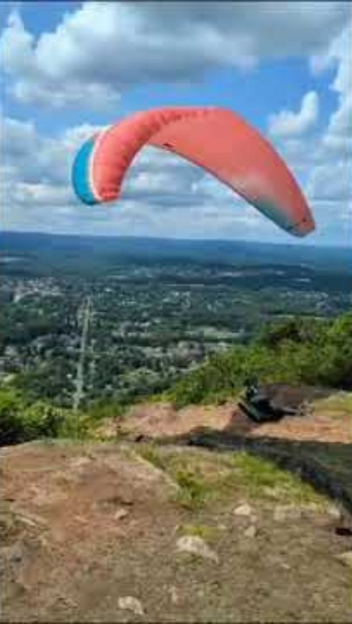
Practice: Mistakes in Launching
Is this a good launch?
What went wrong here? And how could it have been prevented?
Launch #1

Slide 34
Practice: Mistakes in Launching
Is this a good launch?
What went wrong here? And how could it have been prevented?
Pilot may have been able to slow the wing down a bit more as it came up. As it happened, wing came up very fast and overshot. Wing did not collapse because pilot got lifted at the same time (wing was loaded).
Pilot got dragged in reverse and didn’t try to abort (probably a good decision).
Pilot then got into a thermal and did a good job actively flying the glider.
Letting glider overshoot while getting lifted is frequent with cliff launches: Don’t launch novices from cliff launches in strong or thermic conditions (e.g., our top windstation launch at Ma Ma).
If possible: Get pilots to abort launch early

Slide 35
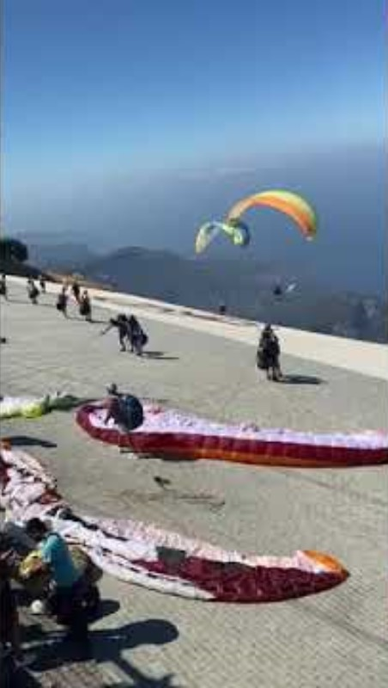
Practice: Mistakes in Launching
Is this a good launch?
What went wrong here? And how could it have been prevented?
Launch #2

Slide 36
Practice: Mistakes in Launching
Is this a good launch?
What went wrong here? And how could it have been prevented?
Early detection of the conflict is key
If you are a pilot in this scenario:
Communicate: “You go left, I go right”
As SO: Instruct one of the pilots to abort launch early.
In later stage: It may have worked to ask the UP pilot to slow the glider.
Usually, as soon as two pilots are entangled: Throw the reserve!
But here: Probably too low for reserve throw

Slide 37
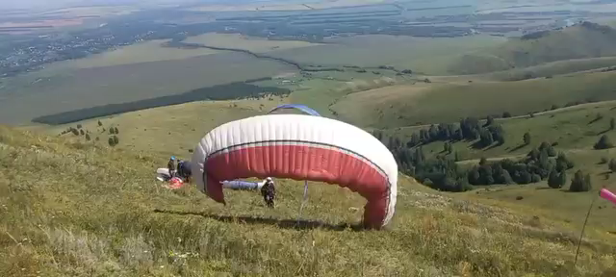
Practice: Mistakes in Launching
Is this a good launch?
What went wrong here? And how could it have been prevented?
Launch #3

Slide 38
Practice: Mistakes in Launching
Is this a good launch?
What went wrong here? And how could it have been prevented?
Pilot launched with cravatte and instead of steering the glider, the pilot got into the harness. Once inside the harness, the pilot fell into collapsed side, causing glider to turn into the hill.
SO could advise pilot via radio to weight shift to flying side, and apply some (gentle) brake on the left to keep glider flying straight.
Once glider is flying straight and there is enough distance to the ground, pilot can try to get cravatte out – by pulling on brake, Stabilo line (most outward line on wingtip) or all A-lines (riser).
Pulling the A-riser will produce an asymmetric collapse, which may free the lines, but it will also produce more drag. Pilot may have to apply some extra brake to the flying side to keep glider straight.

Slide 39
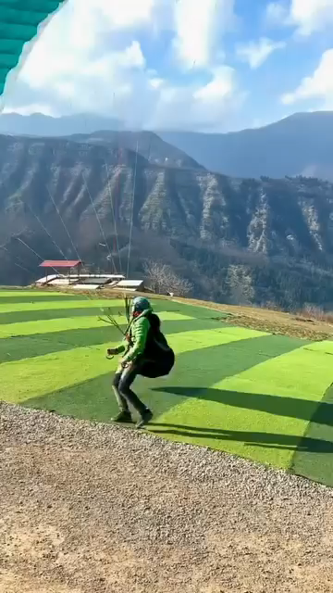
Practice: Mistakes in Launching
Is this a good launch? What went wrong here? And how could it have been prevented?

Slide 40
Practice: Mistakes in Launching
Is this a good launch? What went wrong here? And how could it have been prevented?
Pilot is trying very hard to look cool and in control, but is in the danger zone:
Too far back for the conditions: It’s strong and cross (big mistake). Pilot depends on luck at this stage (could be dragged or lifted and blown back).
Pilot repeatedly puts glider into the power zone and gets lifted a few times and still does not abort.
Ask pilot to abort, bunch up the glider and move to the front of the launch. Make sure they understand why it’s no good launching so far from the back in these conditions.
Feel free to mention that this does not look cool at all. ;-)

Slide 41
Supervising Flights

Slide 42
Supervising Flying
SO’s can fly when supervising PG2’s. SO should stay in line of sight with pilot and have good radio comms.
If you as SO want to fly away, make sure another SO or Duty Pilot (PG4 or above) can take over before you leave.
Things we can advise on:
Avoid flying into dangerous areas (rotor, or too far back when it’s strong)
Flying in a hazardous manner: They may need reminders of the rules of the air (e.g., how to avoid collisions when approaching other people head-on or when joining a thermal).
Advise them of other pilots nearby (e.g., when they are boxing other people in), air traffic nearby (e.g., choppers), and airspace
How to deal with equipment problems (e.g., stick in the lines: always turn into the direction of the stick, don’ t use speed-bar)

Slide 43
Limitations in Supervising Flying
Never try to take responsibility for the pilot’s actions. Make sure they make the decisions.
We want them to grow!
Note that there is a visual illusion: Other PG’s always look further away than they are. It often seems like PG2 is too far from LZ or too far behind the ridge, when in fact they are directly above these landmarks.
We can only judge their position clearly when we are directly above or below, or when we see the shadow on the ground (and compute position relative to sun).
→ Be careful with your suggestions. Make sure pilots understand when we are making assumptions.
Example of bad call: “You are too far behind the ridge. Come forward.”
Example of a good call: “It seems to me that you may be too far behind the ridge. Maybe check whether you can make it back.”

Slide 44
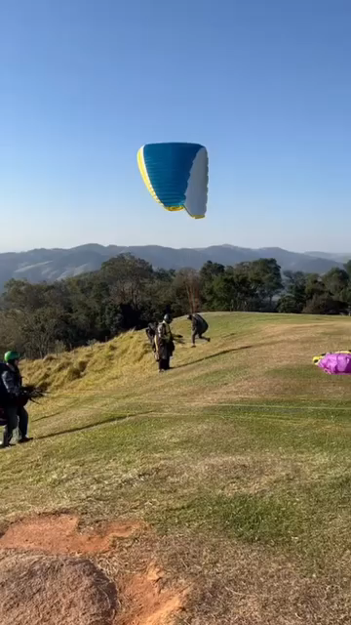
Practice: Mistakes in Flight
What went wrong here? And how could it have been prevented?
Launch #1

Slide 45
Practice: Mistakes in Flight
What went wrong here? And how could it have been prevented?
Pilot is applying deep brakes for a prolonged time.
Pilot slides side-ways behind the top of the hill instead of piloting in front of the hill or out.
Suggest to pilot to ease off the brakes and get in front of the hill. Explain that there is often sink behind the top and that obstacles and trees can produce turbulence (rotor).
If there is a pilot in a tree: Advise them to hold still and NOT to climb out. Pilot should wait for rescue unless we are 100% confident that they can climb out themselves without injuring themselves.
Talk to pilot about incident reports.

Slide 46
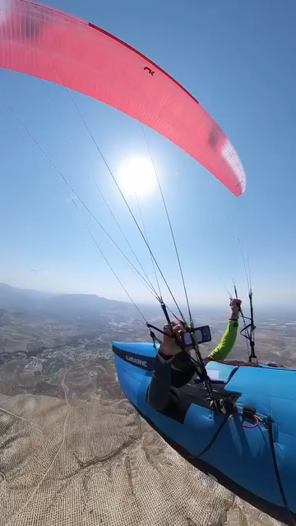
Practice: Mistakes in Flight
What went wrong here? And how could it have been prevented?

Slide 47
Practice: Mistakes in Flight
What went wrong here? And how could it have been prevented?
Pilot does not keep hands on the brakes, suffers asymmetric collapse. Glider cravattes during reinflation and dives, then goes into a spiral. Instead of getting glider out of the spiral, pilot tries to clear the cravatte first. Pilot eventually applies full brakes and gets glider out of spiral, and then clears cravatte.
Danger that pilot may pass out and impact the ground with a fatal speed.
When it happens to you and you know you can take the G’s from a normal spiral: Try to get glider out of spiral FIRST, then try to clear cravatte.
As SO: Best advice is probably to throw the reserve IMMEDIATELY.
Talk to pilot later about incident reports and Krakenings after successful reserve throws. ;-)

Slide 48
Supervising Landings

Slide 49
Supervising Landings
Only easy when you are standing in the LZ. In flight, the visual illusion applies, so we often cannot determine where they are, or supervise their landings.
It’s fine if we cannot provide any guidance – they are certified pilots.
What we can do:
Observe trailing edge and position of hands / brakes: Most serious mistake in landing is to stall glider → serious injuries. Stalling glider is especially likely when there is no wind / tailwind and/or pilot is overshooting / facing obstacles.
→ Best advice to prevent or manage stall: Let the glider fly; get out of harness.
When pilot is going to impact hard on their bum: Suggest to turn to the side.
If confident about the position of the pilot, we can try to help them make corrections to their landing approach.
We can manage possible conflicts between gliders.
We can offer feedback during debriefing.

Slide 50
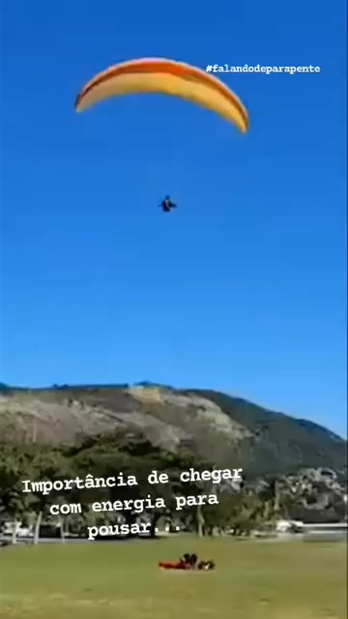
Practice: Mistakes in Landings
What went wrong here? And how could it have been prevented?
Landing No. 1

Slide 51
Practice: Mistakes in Landings
What went wrong here? And how could it have been prevented?
Pilot is applying deep brakes and stalling the glider
Asymmetric → gliders goes into a spin, where one half of the wing is stalled and turns negatively.
To get out of stall, pilot would need to put hands up.
But: If pilot puts hands up, danger of glider shooting forward asymmetrically, which can lead to high-velocity impact when close to the ground.
Suggest to pilot to assume PLF position to minimise injuries (“Get out of your harness”)
Try to prevent stalls: Observe trailing edge and brakes/hands when pilots are landing.

Slide 52
De-Briefing and Incident Reporting
After an accident or incident, de-briefing is important to help pilots understand what went wrong and to identify strategies to prevent similar situations in the future (essential for feeling in control & confidence).
Before starting the de-brief, make sure that pilot is well and cognitively able to engage.
In the debrief, first ask the pilot what they think they did wrong (don’t just tell them).
When you both agree on the mistakes, ask pilot to identify appropriate alternatives / strategies to prevent repeating the mistake.
Encourage pilot to fill out incident report & offer help with this, as additional opportunity for analysis and reflection.

Slide 53
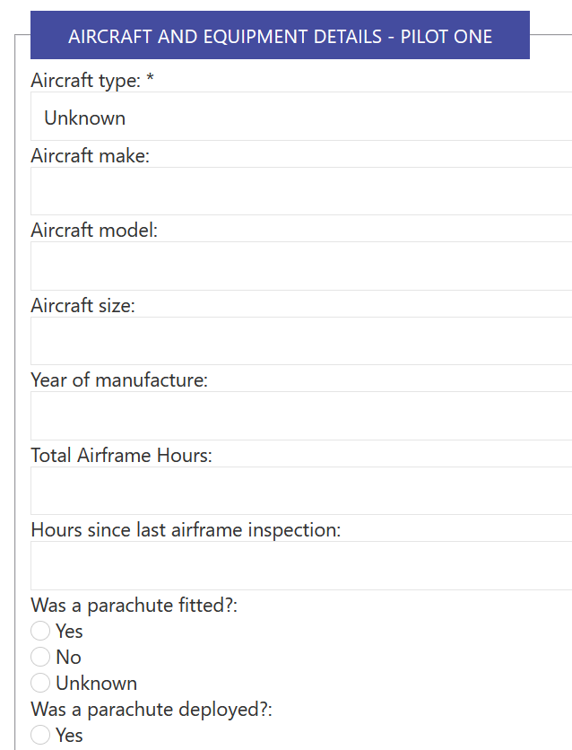
Incident Reporting
Everyone can submit an incident report, at SAFA website: https://members.safa.asn.au/members.php?page=public-incident-report.php
Details of pilot need to be provided to SAFA, but in the report, pilot will remain anonymous. (PIC = “pilot in command”)
If you provide an incident report for someone, try to make sure you have their details and know what equipment they were using (harness, wing).
It’s best to review incident with pilot (what they could have done better), and get the pilot to do the report.

Slide 54
Accidents
Often SO will be asked to manage things around an accident or incident.
This can include:
Rendering first aid. → Find the best person for that & render assistance.
Call an ambulance, and organize someone to meet them. OR:
Organize transport for pilot to hospital if not seriously hurt; take care of their gear and car.
Managing site when they send a helicopter. → It will typically take time for chopper to arrive, so: Make sure that wings are packed up, not open at launch
Inform people about the accident. This can be more difficult than it sounds. Radio comms may not be working. If you have time, think creatively.
Suggest to pilots in the air to leave the area and go XC or to land.
Inform the club committee

Slide 55
Reporting of Risks and Hazards
All threats and hazards at the flying site should best be reported to club committee.
Everyone can submit a risk and hazard report at the SAFA website:
https://members.safa.asn.au/members.php?page=member_view_th.php
However: SAFA website only seems suitable for reporting some hazards; e.g.:
Threats and hazards due to unsafe flying behaviour, especially of tandem pilots For example: A tandem pilot failed to clip in passenger. You noticed it and corrected it before they took off.
Threats and hazards due to intoxication of pilots (without incidents)
Threats and hazards due to unsafe flight operations of other aircraft (e.g., helicopters at Mt Storey regularly flying too close).

Slide 56
Our Site Ratings

Slide 57
Site Ratings
Inspired by SAFA:
PG2:
Slope no steeper than 3:1 at launch pad (but then steep)
No obstructions within 45-60 degrees of intended flight path
Wind not too strong or too cross; no strong gusts or funky thermals
LZ is large, flat and largely free of obstacles that could cause injury
PG3:
Slope no steeper than 4:1 at launch pad
No obstructions within 30-45 degrees of intended flight path
Wind not too strong or too cross
LZ can be smaller or not so flat, largely free of obstacles

Slide 58
Our Site Ratings
How would you rate our sites?
For the ratings, consider both (1) ease of launch; (2) ease of landing
Assume perfect conditions. SO or duty pilot of the day can always change the rating of a site depending on conditions (too strong, too cross, etc.)
Ma Ma (low E/NE launch): Currently PG2
Tenthill (W launch): PG3.
Wilson’s (NE launch): PG4.
Killarney (SE launch): PG3.
Killarney (W-NW launch): PG4.
Killarney (N launch): PG2.
Stringybark: PG3.

Slide 59
How to get approved as SO?

Slide 60
How to get approved as SO?
Go to SAFA website, log in (Member Login and Renewals): https://safa.asn.au/
After you have logged in, go to Documents and then, Forms
Select APP-01 Safety Officer and Senior Safety Officer Application / Renewal
(https://safa.snapforms.com.au/form/app-01-safety-officer-appointment-applicationv149020240510)
Fill out the form, give my name (Secretary): Stefanie Becker
And my phone number: 0449 883870.
Maybe text me while you are doing that to see if I’m free to approve it. ;-)

Slide 61


Any questions?

